Slide 1
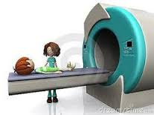
Preprocessing: Realigning and Unwarping
Methods for Dummies, 2016/17
Jakub Jilek
Samira Kashefi

Slide 2
What this talk covers
Preprocessing in fMRI : Why is it needed?
Motion in fMRI
Realignment
Unwarping
How this all works in SPM
Jakub Jilek
Samira Kashefi

Slide 3
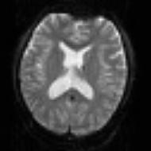


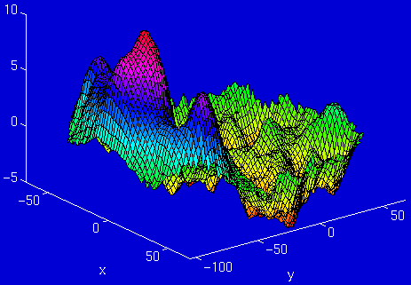
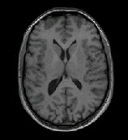
Stages in fMRI analysis
Scanner Output
Preprocessing
Statistical analysis
Today’s talk
Motion correction (and unwarping)
Design matrix
fMRI time series
Smoothing
General Linear Model
Statistical Parameter Map
Spatial normalisation (including coregistration)
Structural MRI
Parameter estimates

Slide 4
Pre-processing in fMRI
4 pre-processing steps:
Realignment
Unwarping
Co-registration
Spatial normalisation

Slide 5
Preprocessing: Why is it needed?
fMRI:
  returns a 3D array of voxels repeatedly sampled over time
  Changes in activation in each voxel correlated with experimental task
Key Assumptions:
  1) the voxels need to come from the same part of the brain
  2) all voxels must be acquired simultaneously
Notes:
fMRI analysis looking at a 3D matrix of voxels repeatedly sampled over time
how fMRI works: We look at intensity of activation in a voxel at a given point of time. We plot this along with various tasks, and if activation varies with the task, we can correlate brain function.
To do this, first step we must ensure we are looking at same brain region over time.
QN: Do we need to talk about slice timing? I understand this in theory: There’s a TR (usually 3s?) gap between acquisition of the first slice and the last slice in each scan. And we have various methods of interpolating the images to ensure this timing gap doesn’t affect data. But is this a step we do in SPM? And if so when is it done – before realignment or after?
Regarding slice-timing, I'd mention the fact

Slide 6
Violation of assumption 2:
  - all voxels must be acquired simultaneously
  X the last slice is acquired TR seconds after the first slice
  → there can be motion of one slice relative to another
Solution:
  slice-timing correction: include realignment parameters in the model
  will (hopefully) be discussed in event-related fMRI
Notes:
- there can be motion of one slice relative to another due to the delay, and the fact that the realignment model cannot correct this motion, which is one reason for wanting to include realignment parameters in the linear model. I don't think you need to discuss slice-timing-correction itself, since this will probably be discussed in the talk on event-related fMRI. The choice of whether to have STC before or after realignment (or not at all) is still a matter of debate, depending on some subtle things like whether the slices are acquired with an "interleaved" sequence or not, and how much motion there is (probably too much detail to get into in MfD).

Slide 7
Violation of assumption 1:
  - the voxels need to come from the same part of the brain
  X head thus brains move in the scanner
  → a small movement (< 5mm) means that voxel location is not stable throughout the time series
Voxel A - Inactive
Voxel A - Active

Slide 8
Causes of head movement:
    Physiological: heart beat, respiration, blinking
    Actual movement of the head
    Task-related: moving to press buttons
      artificially creates variance in voxel activation that correlates with task ➔ serious confound
Why is this a problem?
- this variance is often much larger than experiment- induced variance
→ False activations
- lowers the signal-to-noise ratio

Slide 9
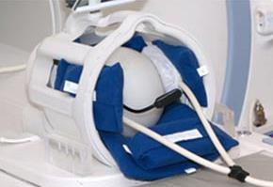
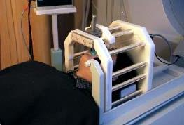
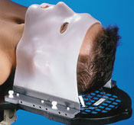
Some solutions
Make volunteer comfortable
Schedule short scanning sessions (best 10 minutes)
Provide instructions not to move head
Constrain volunteer’s movement
Soft padding
Bite bar
Contour mask
X Most variance still remains
Notes:
QN: What’s a good length of time that we can scan for?
Regarding length of scanning sessions, I'm not very well placed to answer, because I haven't done a lot of scanning. It's also very much dependent on what group you are scanning (e.g. children, elderly or patients might only tolerate shorter sessions). I'd probably aim for less than 10 minutes per run, though perhaps I'm being over-conservative there (I think the HCP scan for longer), and for no more than 90 mins total time in the scanner, ideally less than 60.

Slide 10
Other solution: REGISTRATION
= take two images and align them (spatially reshape one to match the other)
→ we need a mapping of each voxel from source to reference
TYPES:
realignment
  = registration that uses a linear transformation
  that preserves shape
unwarping
= registration using non-linear transformation
that modifies shape

Slide 11
Realignment: Stages
1) specifying the transformations;
2) choosing a way of measuring the similarity between transformed images;
3) find the transformation function parameters that maximise the similarity
4) conduct the transformation

Slide 12
Realignment: Stages
1) specifying the transformations
2) choosing a way of measuring the similarity between transformed images;
3) find the transformation function parameters that maximise the similarity
4) conduct the transformation

Slide 13
1) specifying the transformation:
characterised by DOF = degrees of freedom
choose the transformation function
b) choose the interpolation function

Slide 14
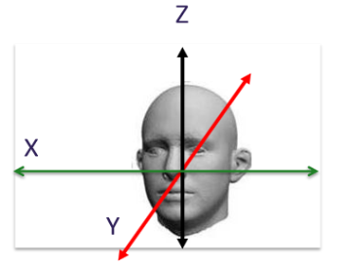
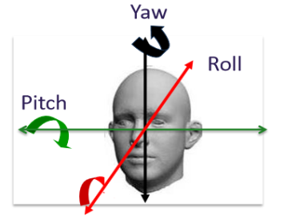
a) Transformation function: rigid-body
assumes that shape and size of brain images do not change → for within subject
preserves the distance between any 2 points
A reference image is chosen (usually first image)
Estimate 6 parameters to minimise the sum of squared differences between each scan and a reference scan:
  3 translations (x, y, z)
  3 rotations (degrees)
    ➔ 6 DOF
Translation
Rotation
Notes:
Motion correction uses a correction cost function: measures variance to see if images are a good match. Smaller variance = better match (least squares). The realigning process is iterative: Image is moved a bit at a time until match is worse.

Slide 15
b) Interpolation
Interpolation involves constructing new data points based on known data
Simple interpolation:
  Nearest neighbour: Take value of closest voxel
  Tri-linear: Take weighted average of neighbouring voxels
B-Spline interpolation
  Improves accuracy – SPM uses this as standard
  uses information beyond the neighbouring voxels
Notes:
All images are acquired and stored as a collection of discrete points set on a spatial grid. However, in order to carry out the image transformations the intensity at positions between grid points needs to be calculated. This process is called interpolation.
WHY do we need to do this?

Slide 16
Realignment: Stages
1) specifying the transformations;
2) choosing a way of measuring the similarity between transformed images;
3) find the transformation function parameters that maximise the similarity
4) conduct the transformation

Slide 17
2) Choose a similarity / cost function
- quantifies how (dis-)similar the images are after a spatial transformation has been applied

Slide 18
Realignment: Stages
1) specifying the transformations;
2) choosing a way of measuring the similarity between transformed images;
3) find the transformation function parameters that maximise the similarity
4) conduct the transformation

Slide 19
3) Find the transformation function parameters that maximise similarity
Mathematical optimisation problem
no easy analytical solution
tradeoff between robustness and speed of processing

Slide 20
Realignment: Stages
1) specifying the transformations;
2) choosing a way of measuring the similarity between transformed images;
3) find the transformation function parameters that maximise the similarity
4) conduct the transformation

Slide 21
4) Apply the transformation function by resampling the data using interpolation
 | Raw data | After re-alignment
Brain area
Scanned slices
t = 1
t = 2
t = 3
t = 4
t = 5
t = 6
Missing data
- set of mathematical equations that relate the old image coordinates to the new ones

Slide 22
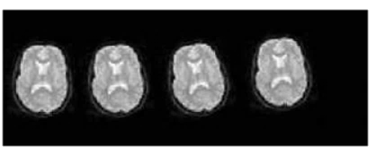
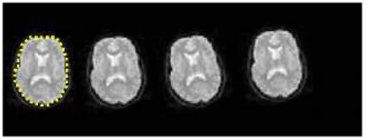
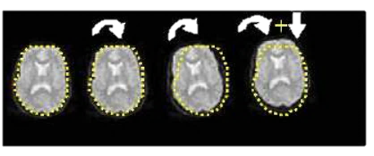
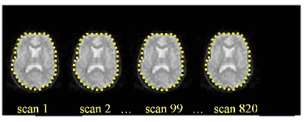
Summary
Series of scans with head movement
Calculate position of brain for first slice (Reference Image)
Estimate transformation parameters based on Reference Image
Apply transformation parameters on each slice (using interpolation)

Slide 23
References and further reading
Slides from previous years of the MfD course
(http://www.fil.ion.ucl.ac.uk/mfd/)
MRC CBU Cambridge, Imaging Wiki
(http://imaging.mrc-cbu.cam.ac.uk/imaging)
Nipype Beginner’s guide to neuroimaging
(http://miykael.github.io/nipype-beginner-s-guide/neuroimaging.html)
Andy’s Brain blog
(http://andysbrainblog.blogspot.co.uk/2012/10/fmri-motion-correction-afnis-3dvolreg.html) Also has cool video showing the 3 translations and 3 rotations.
Huettel, S. A., Song, A. W., & McCarthy, G. (2004). Functional magnetic resonance imaging. Sunderland: Sinauer Associates.

Slide 24
REGISTRATION
TYPES:
realignment
  = registration that uses a linear transformation
  that preserves shape
unwarping
= registration using non-linear transformation
that modifies shape

Slide 25
After realignment:
Why unwarp?
In extreme cases up to 90% of the variance in fMRI time-series can be accounted for by effects of movement after realignment.
Notes:
Even after realignment there is considerable variance in fMRI time series that covary with, and is most probably caused by, subject movements.
It is also the case that this variance is typically large compared to experimentally induced variance.
In fact, in severe cases up to 90% of the variance after realignment can be caused by movement.

Slide 26
The effect include
Subject Movement between Slice Acquisition
Interpolation Artifact
“spin-excitation” history effect
“nonlinear” distortion due to magnetic field in homogeneities

Slide 27
This can lead to two problems, especially if movements are correlated with the task:
  Loss of sensitivity (we might miss “true” activations)
  Loss of specificity (we might have false positives)

Slide 28
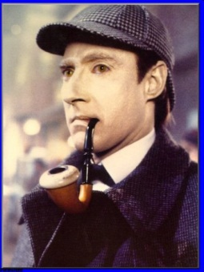
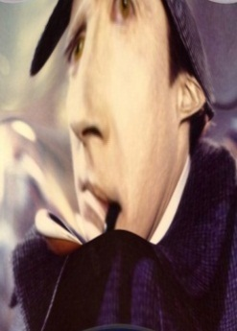
Unwrap tackles non-linear distortion from magnetic field inhomogeneities
Different substances in the brain are differentially susceptible to magnetization
2) Inhomogeneity of the magnetic field
3) Distortion of the image
Notes:
When placed in a large magnetic field, tissues are temporarily magnetized, with the extent of the magnetization depending on the magnetic susceptibility of the tissue. As you know that brain have different type tissue such as grey/white matter, and substances such as CSF, Blood and so on which have slightly different magnetization. This alters the local magnetic field.

Slide 29
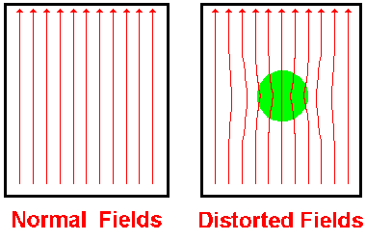
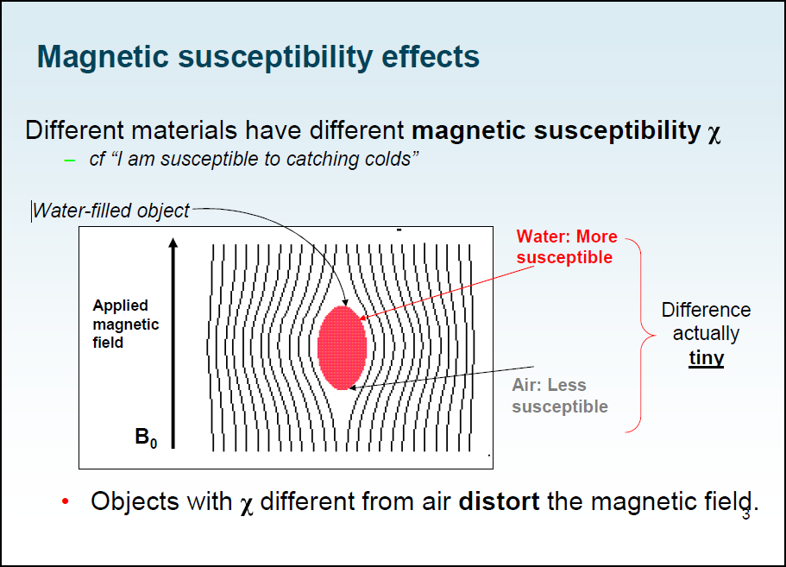
  Unwrap tackles non-linear distortion from magnetic field inhomogeneities
Notes:
The difference in tissue susceptibility causes field inhomogeneity between tissue boundaries, which makes spins dephase faster, producing signals of low intensity. This signal loss is especially severe at air-tissue or bone–soft tissue boundaries, because air and bone have much lower magnetic susceptibility. Local magnetic fields tend to take on different configurations around these interfaces, and introduces geometric distortion into the resultant images.

Slide 30


This effect is called Movement-by-distortion interaction.
These geometric distortions are because of miss-mapping of the MR signal in either the frequency encoding or the phase encoding direction. Therefore it may lead to alteration of the original shape in the appearance of anatomic structures
this is what’s taken care of when unwarping→
Notes:
Such field inconsistencies may lead to distortion in the appearance of anatomic structures because of mismapping of the MR signal in either the frequency encoding or the phase encoding direction.

Slide 31
How unwarping reduce distortion
Unwarp can estimate changes in distortion from movement by
Measure the distortion field with Fieldmap
  Observe subject motion parameters (that we obtain in realignment)
change in deformation field with subject movement (estimated via iteration)
To give an estimate of the distortion at each time point.
Notes:
We estimate how the deformations change when the subject changes position.
A deformation field indicates the directions and magnitudes of location deflections throughout the field (B₀) with respect to the real object.
A deformation field can be thought of as little vectors at each position in space showing how that particular location has been deflected.
This is done by formulating the inverse problem, i.e. given the observed variance (after realignment) and known (estimated) movements, we can estimate how deformations change with subject movement.
The underlying model for this is so restricted, so experimentally induced variance (the good variance) is preserved.
To do this we iterate: 1) estimate movement parameters, 2) estimate deformation fields, 1) re-estimate movement …and so on..

Slide 32

Measure deformation field (FieldMap).
Estimate new distortion fields for each image:
estimate rate of change of the distortion field with respect to the movement parameters.
Unwarp time series
Estimate movement parameters
Δϕ
+Δθ
Notes:
To do this we iterate: 1) estimate movement parameters, 2) estimate deformation fields, 1) re-estimate movement …and so on..

Slide 33
Applying the deformation field to the image
Once the deformation field has been modelled over time, the time-variant field is applied to the image.
The image is therefore re-sampled assuming voxels, corresponding to the same bits of brain tissue, occur at different locations over time.

Slide 34
The outcome?
In the end what you get is re-sliced copies of your images
realigned (to correct for subject movement) and
  unwarped (to correct for the movement-by-distortion interaction) accordingly*.
These images are then taken forward to the next preprocessing steps (next week!).
*NB. You can ‘realign’ and ‘unwarp’ separately if you prefer.

Slide 35
Practicalities
Unwarp is of use when variance is due to large movement.
Particularly useful when the movements are task related as can remove unwanted variance without removing “true” activations.
Can dramatically reduce variance in areas susceptible to greatest distortion (e.g. orbitofrontal cortex and regions of the temporal lobe).
Useful when high field strength or long readout time increases amount of distortion in images

Slide 36
Limitations
It doesn’t remove movement-related residual variance coming from other sources, such as spin-history effects and slice-to-volume effects
Can be computationally intensive… so take a long time

Slide 37
All very well, but how do I actually do this?
In scanner: acquire 1 set of fieldmaps for each subject
After scanning: convert fieldmaps into .img files (DICOM import in SPM menu)
Use fieldmap toolbox to create .vdm (voxel displacement map) files for each run for each subject
You need to enter various default values in this step, so check physics wiki for what’s appropriate to your scanner

Slide 38
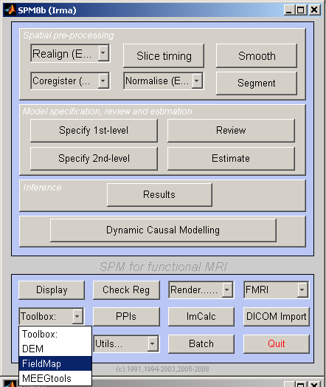
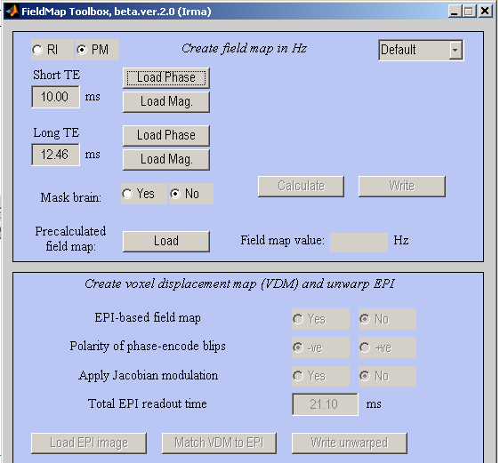
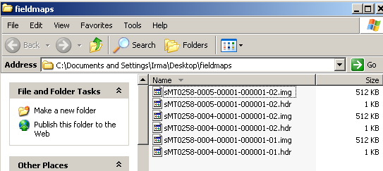
Step 2: fieldmap toolbox on SPM8
If using toolbox, you need to load the right phase and mag images.
phase: one for which there’s only one file with that series number
Mag: the first file of the two files with the same series number
Series number
Notes:
Your epi acquisitions from your various scan sessions/ blocks (eg, 100 acquisitions per block; 4 blocks in your experiment)

Slide 39
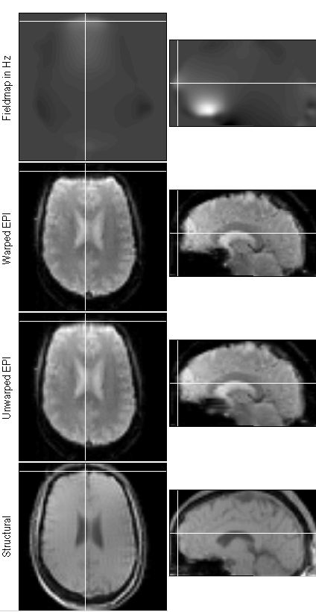
SPM
Make sure to set your ‘Short TE’ and ‘Long TE’ to the correct values
You can check your other defaults (mask the brain)
Press ‘Calculate’ – after a couple minutes a fieldmap is displayed. You can interactively click on the display and the amount of inhomogeneity for that voxel will appear in the ‘Field map value Hz’ field. Several new image files are created, including a voxel displacement image (VDM).

Slide 40
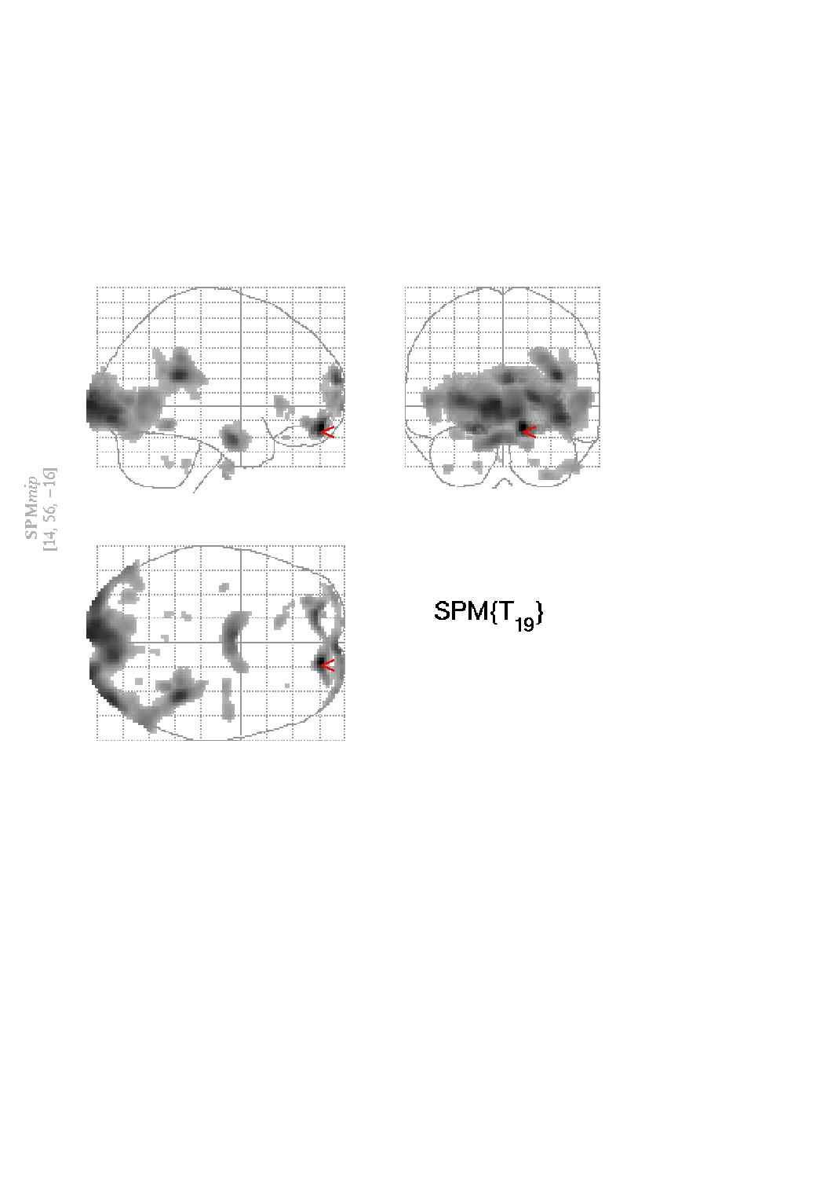
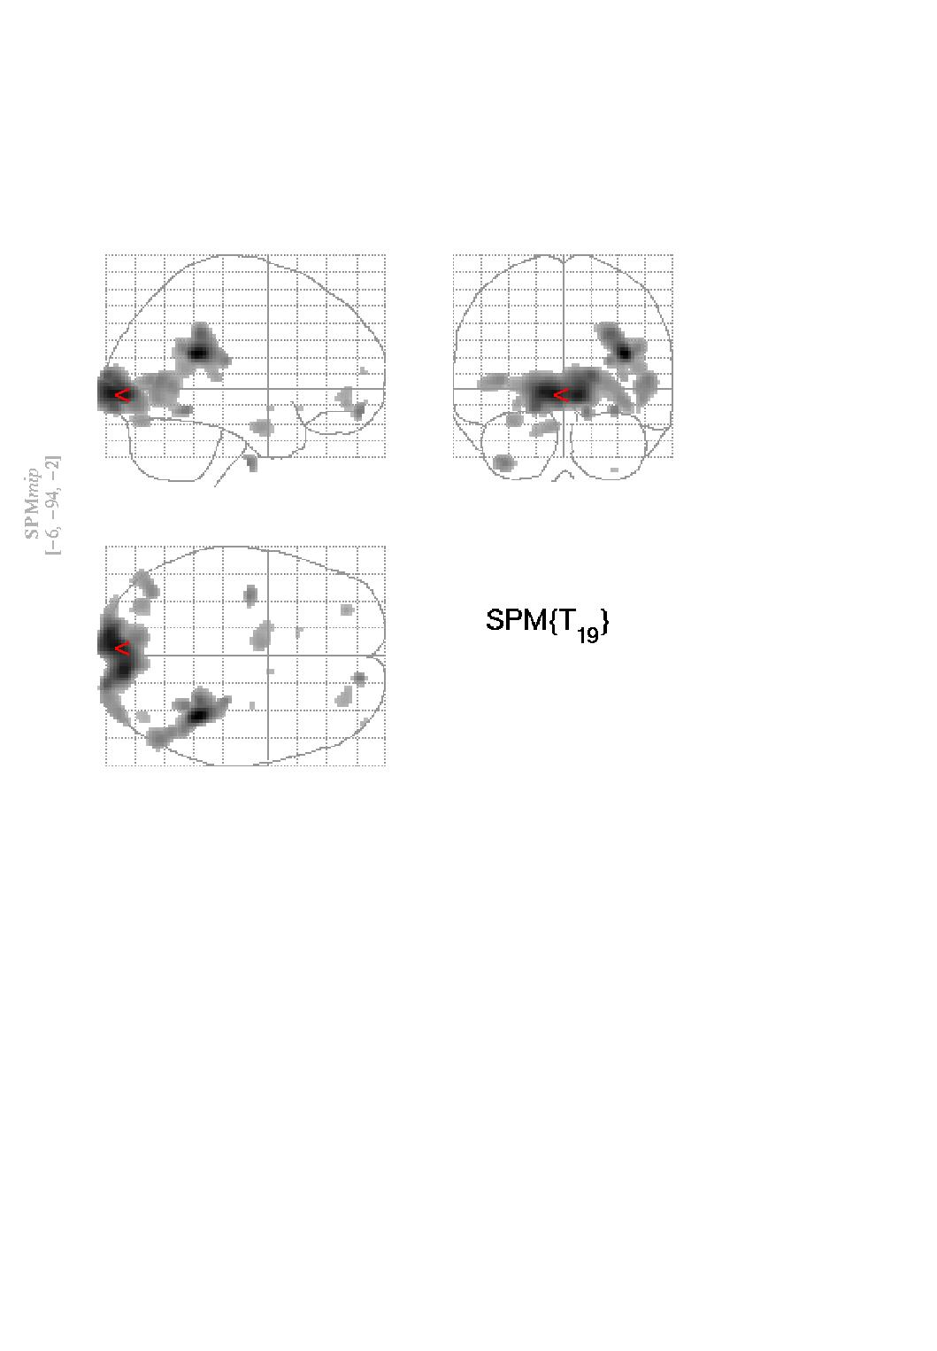
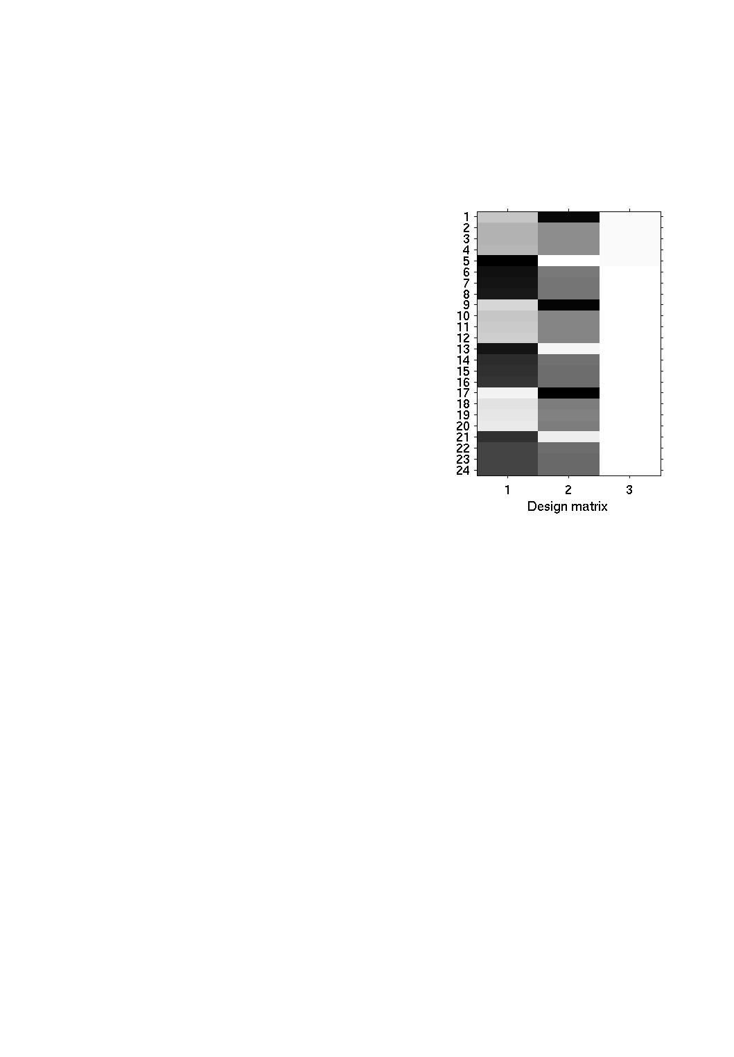
SPM
Press ‘Load EPI image’ and select your functional data, and make sure the Total EPI readout time is set correctly.
Press ‘Load structural’ and select one of your magnitude images
Press ‘Write unwarped’ – a new undistorted image is created
No correction
Correction by Unwarp

Slide 41
References and further reading
Jezzard, P. and Clare, S. 1999. Sources of distortion in functional MRI data. Human Brain Mapping, 8:80-85
Andersson JLR, Hutton C, Ashburner J, Turner R, Friston K (2001) Modelling geometric deformations in EPI time series. Neuroimage 13: 903-919
Previous years MfD slides.
SPM website/ SPM manual

